Slide 1

Department of CSIT
COURSE NAME
FOUNDATIONS OF CLOUD-NATIVE COMPUTING & DEVOPS
COURSE CODE –24CS2260F
Topic:
IAM & secret handling
Session - 1

Slide 2
IAM & Secret Handling Introduction
Why IAM (Identity and Access Management) is Critical:
IAM is critical because it controls who can access what in your system. Without IAM, anyone could potentially access sensitive resources, leading to security breaches.
If IAM is not properly configured:
Unauthorized users might get access to sensitive systems or data (like financial records).
Mistakes in permissions could lead to accidental changes or data leaks

Slide 3
Why Secret Handling is Critical:
Secret Handling protects sensitive information (like passwords, API keys, and database credentials) that your system needs to function. Exposing these secrets can result in major security risks.
If secrets are mishandled:
Attackers could gain access to your database, APIs, or other sensitive systems using exposed credentials.
Sensitive data like credit card details or user passwords could be compromised.
Both IAM and Secret Handling are essential for protecting your system and ensuring that only trusted users and apps can access.

Slide 4
What is IAM (Identity and Access Management)?
IAM is a framework that defines who can access which resources and what actions they are allowed to perform.
It provides a structured way to manage identities and permissions in complex systems.
Authentication verifies the identity of a user or service requesting access.
Authorization determines whether the authenticated identity has permission to perform a requested action.
IAM enforces the principle of least privilege, allowing only the minimum permissions required.

Slide 5
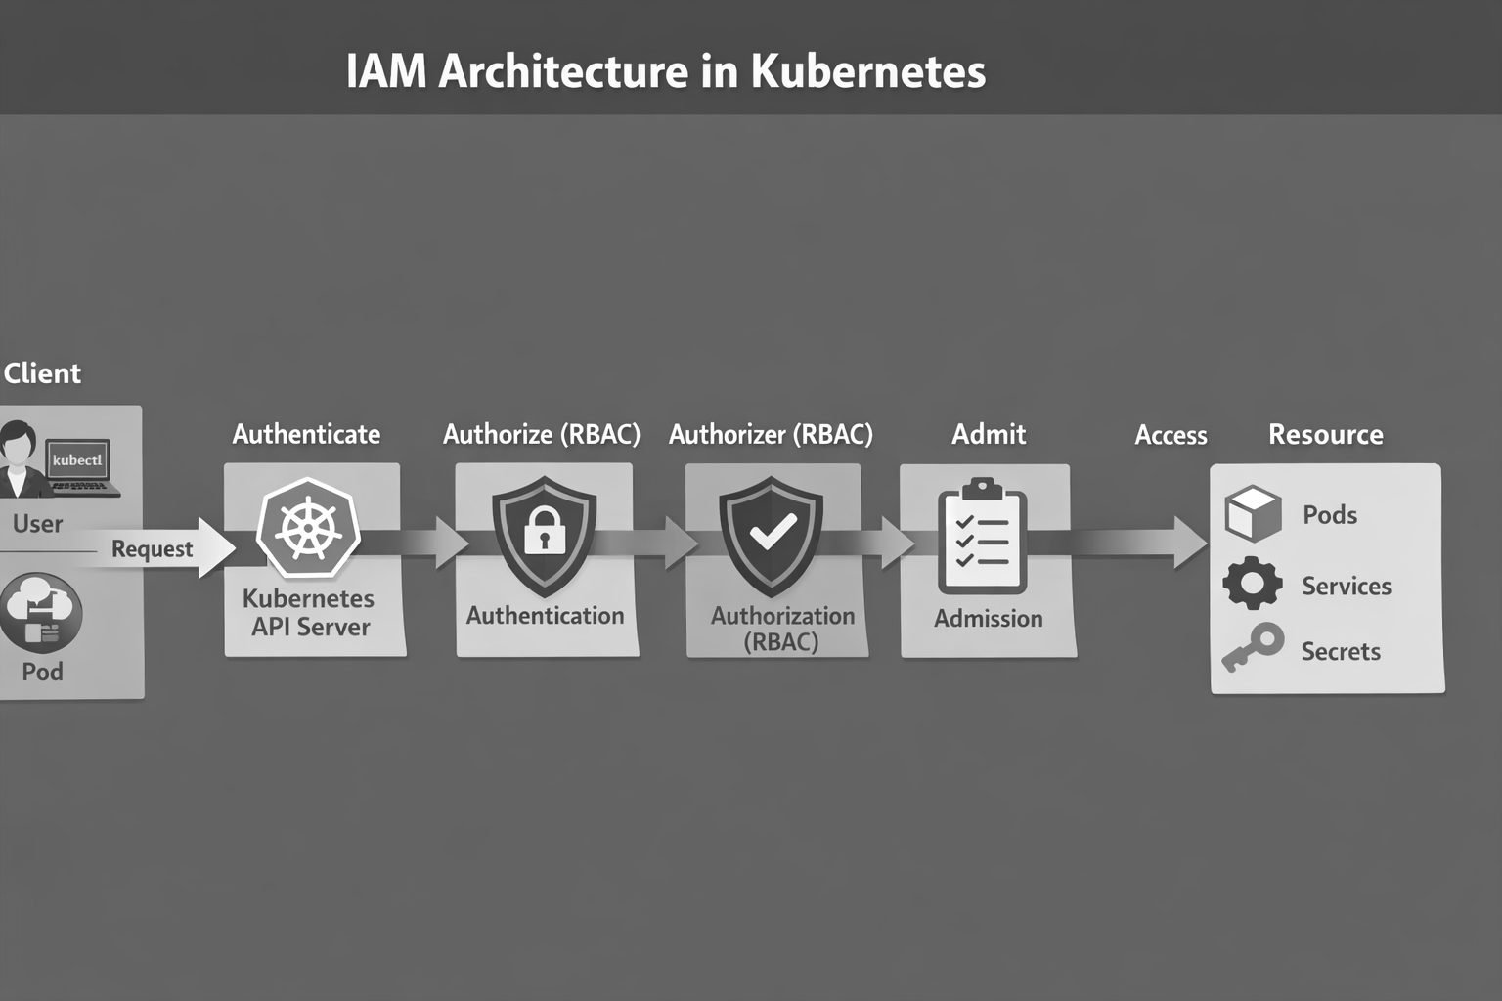
IAM Architecture in Kubernetes

Slide 6
Summary of the Flow:
User Request → The user sends a request.
Authenticate → The Kubernetes API Server verifies the user's identity.
Authorize (RBAC) → The system checks if the user has permission to access the requested resource.
Admit → Admission controllers enforce additional policies before allowing access.
Access Resource → The user gains access to the desired Kubernetes resource (Pod, Service, Secret, etc.).
This flow ensures that only authenticated users with the right permissions can access or modify Kubernetes resources in a secure and controlled way.

Slide 7
Authorization in Kubernetes
Authorization answers the question: “What is the requester allowed to do?”
After authentication, Kubernetes evaluates permissions using authorization policies.
Kubernetes supports multiple authorization modes, including RBAC and ABAC.
Role-Based Access Control (RBAC) is the most commonly used and recommended approach.
Authorization ensures that users and pods cannot perform unauthorized actions.

Slide 8
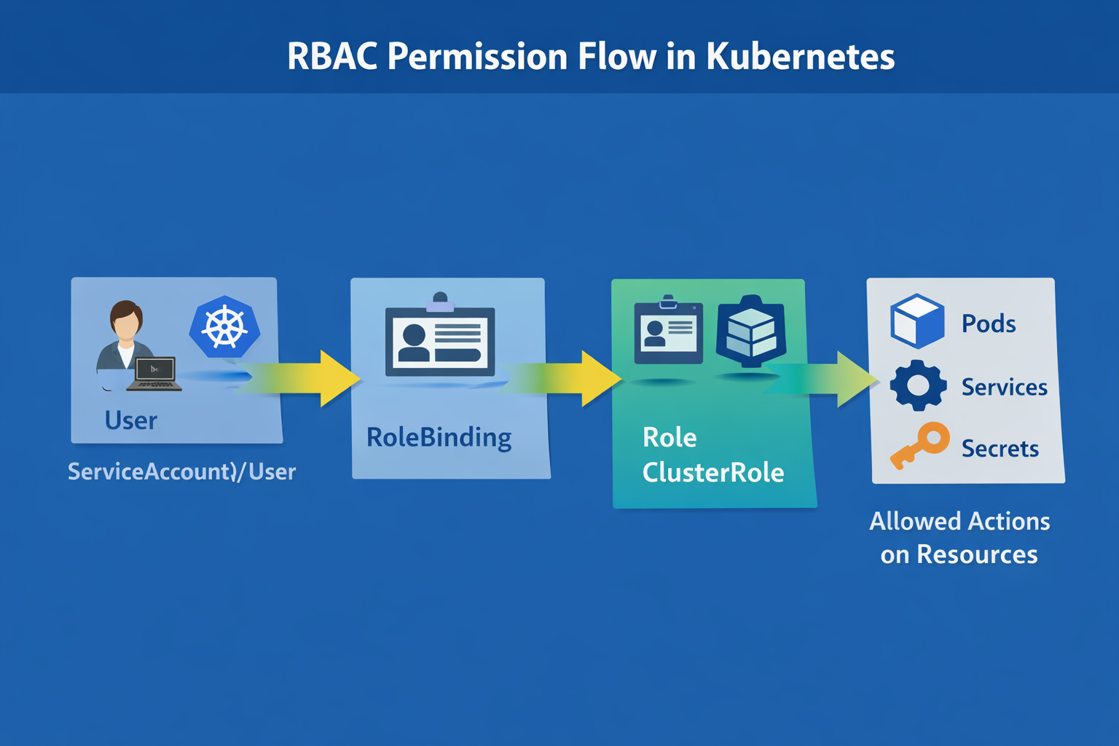
RBAC Permission Flow in Kubernetes

Slide 9
Summary of the flow :
User or ServiceAccount makes a request.
The request is matched with a RoleBinding that binds the user/service account to a Role or ClusterRole.
The Role or ClusterRole defines what actions are allowed on specific Kubernetes resources.
The user or service account is granted access to perform those actions on resources like Pods, Services, or Secrets.
This process ensures that only authorized users or services can access and manipulate resources within the Kubernetes cluster, following the principles of least privilege and segregation of duties.

Slide 10
Introduction to Secrets in Kubernetes
Most applications require sensitive configuration data to function correctly.
Examples include database credentials, API keys, and TLS certificates.
Storing such data in plain text configuration files is insecure.
Kubernetes Secrets provide a safer way to store and manage sensitive information.
Secrets help reduce accidental exposure in application manifests.

Slide 11
What Are Kubernetes Secrets?
Kubernetes Secrets are specialized objects designed to hold confidential data.
The data is stored in Base64-encoded format within the cluster.
Secrets can be referenced by pods without embedding sensitive values in YAML files.
This separation improves security and maintainability.
Secrets are still protected by Kubernetes access control mechanisms.

Slide 12
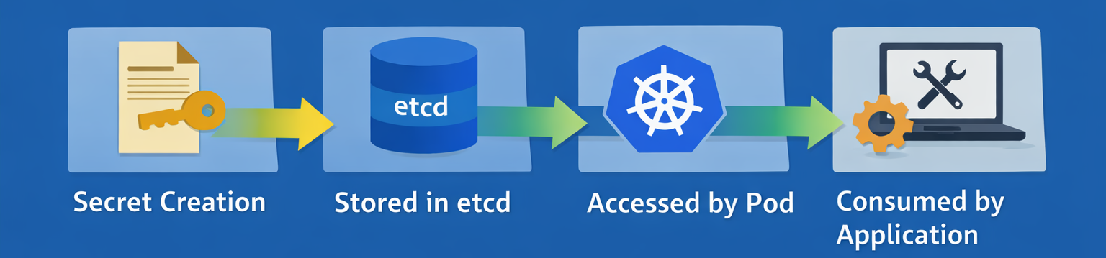
Kubernetes Secret Lifecycle
Secrets are stored in etcd, Kubernetes’ backing data store.
They are scoped to namespaces for isolation.
Pods access secrets only if permitted by RBAC.
The application consumes the secret at runtime.

Slide 13
Types of Kubernetes Secrets
1. Opaque Secrets:
Purpose: Stores arbitrary key-value pairs, typically used for storing sensitive information like passwords, tokens, or configuration values.
When to Use:
When you need to store general secrets (e.g., application passwords, API tokens, or configuration data) that don't fit into other categories.
When there’s no specific structure required for the secret, and it’s just simple key-value pairs.
Examples: Storing a database password, OAuth tokens, or API keys.

Slide 14
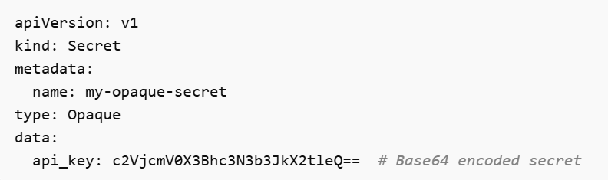
Example Use Case:
An application needs to authenticate with an external service, and you store the API key as an opaque secret.

Slide 15
2. TLS Secrets:
Purpose: Specifically stores TLS (Transport Layer Security) certificates and their corresponding private keys for securing communication (e.g., HTTPS, mTLS).
When to Use:
When you need to securely manage SSL/TLS certificates and private keys for encryption of communication between services or external clients.
Used in cases where Kubernetes components (like Ingress Controllers) need to use TLS certificates for secure HTTP connections.
Examples: Storing certificates and keys for secure communication between your application and clients, or between services in your Kubernetes cluster.

Slide 16
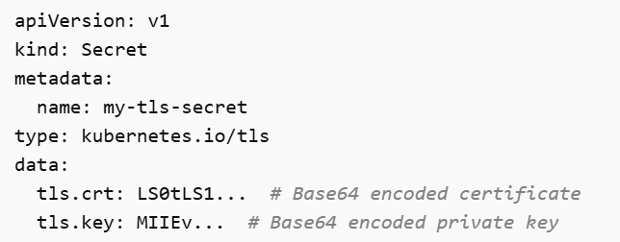
Example Use Case:
A web application that requires HTTPS for secure communication, so you store the SSL certificate and its private key in a TLS secret.

Slide 17
3. Docker Registry Secrets:
Purpose: Stores credentials for accessing private Docker container image registries (e.g., Docker Hub, private container repositories).
When to Use:
When you need to pull container images from a private registry that requires authentication.
Useful when your Kubernetes cluster or its pods need to pull images from private repositories that are not publicly accessible.
Examples: Storing Docker Hub login credentials, or credentials for any other private container registry.

Slide 18
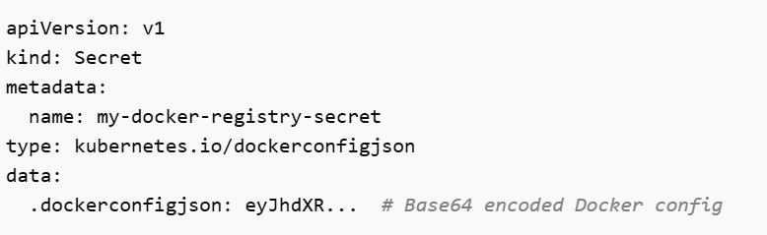
Example Use Case:
Your Kubernetes cluster needs to pull a private container image from a Docker registry, so you create a Docker Registry secret with your credentials.
By selecting the appropriate secret type, you ensure that the secret is stored securely and in the right format for your use case, improving both clarity and security in managing sensitive data within your Kubernetes cluster.

Slide 19
What are Sealed Secrets?
Sealed Secrets provide an encrypted way to manage Kubernetes secrets.
Secrets are encrypted using public-key cryptography before storage.
The encrypted data can be safely committed to Git repositories.
Only the Sealed Secrets controller inside the cluster can decrypt them.
This approach aligns well with GitOps workflows.

Slide 20
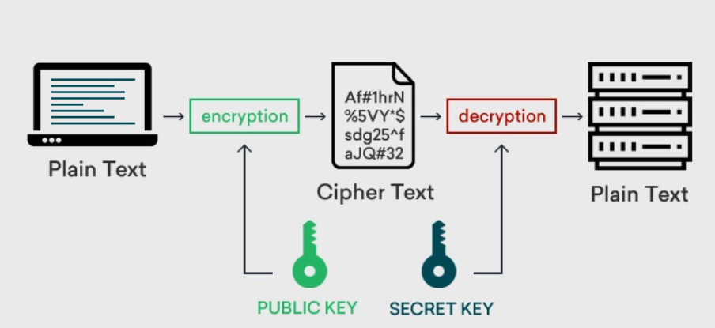

Slide 21
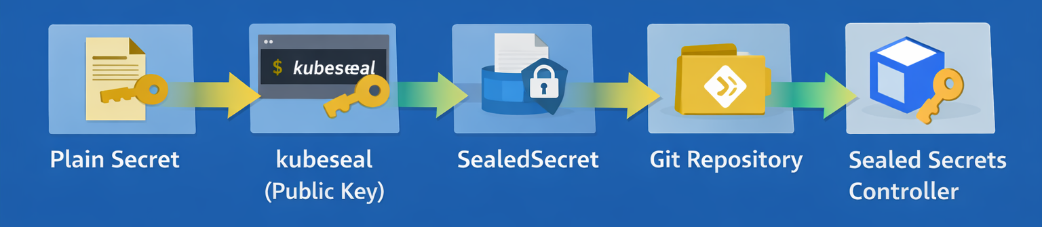
Sealed Secrets Architecture
Encryption happens outside the cluster.
Decryption happens only inside the target cluster.
This prevents accidental exposure of sensitive data.
Secrets remain protected throughout the CI/CD pipeline.

Slide 22
Feature | Secrets | Sealed Secrets
Encryption | No encryption (Base64 encoded) | Encrypted with public key before storage
Storage | Stored in plaintext in etcd | Stored in encrypted form in etcd
Access Control | Controlled by RBAC | Controlled by RBAC and encryption
Security | Less secure unless encryption is configured at rest | More secure due to encryption at rest
Use Case | Suitable for internal, short-term use with proper encryption at rest | Suitable for long-term, secure storage of sensitive data

Slide 23
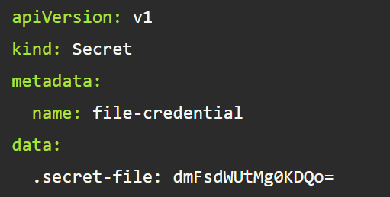
How to create a secret in Kubernetes
1. Encode the secret value in Base64
Before adding a Secret to Kubernetes, the sensitive data must be encoded in Base64. Run the following command to encode your secret value:
echo -n "value-2" | base64
2. Create a secret YAML manifest
Now, define the Secret in a YAML file using the encoded value. Create a new file called secret.yaml and add the following content:

Slide 24
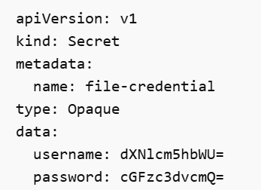

Slide 25
In above file:
The .secret-file key represents the name of the secret file inside the pod, and the corresponding value is the Base64-encoded secret.
3. Apply the secret to the cluster
kubectl apply -f secret.yaml
To confirm that the Secret was created successfully, list all Secrets:
kubectl get secrets
To view the specific Secret in YAML format:
kubectl get secret file-credential -o yaml

Slide 26
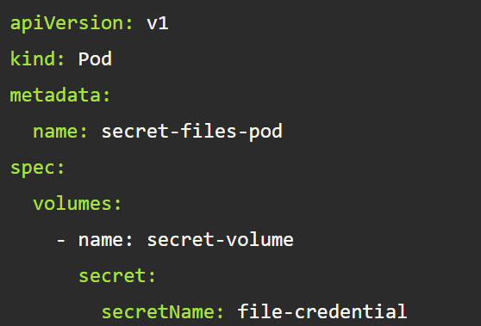
4. Mount the secret in a pod
To allow a pod to use the Secret, you need to define a volume that references it.
file pod.yaml

Slide 27
5. Deploy the pod and confirm the secret is accessible
Apply the pod configuration to deploy the pod:
kubectl apply -f pod.yaml
Check if the pod is running:
kubectl get pods
Question for above process: Apply the process of creating and using a secret in Kubernetes, including encoding the secret in Base64, creating a secret YAML manifest, applying the secret to the cluster, mounting it in a pod, and confirming its accessibility?

Slide 28

THANK YOU
Team –Foundations Of Cloud-native Computing & Devops

